Slide 1
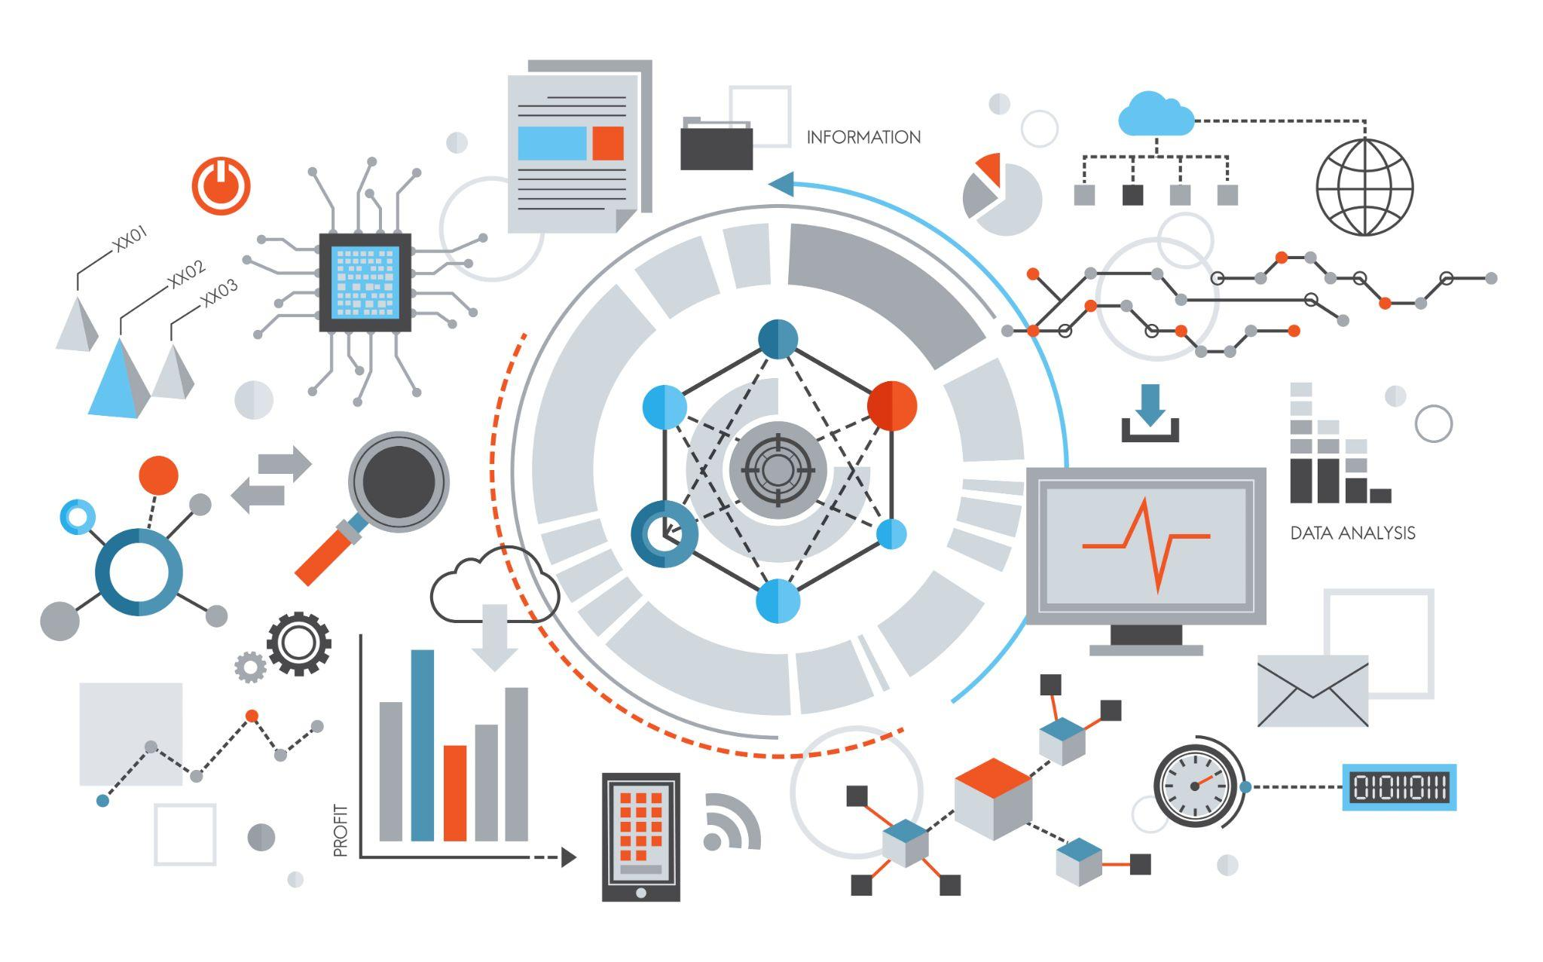
Digital Data
Understanding Digital Data and Binary Systems

Slide 2
Learning Outcomes
Know how computers store information using 0s and 1s (binary).
Understand what bits and bytes are and why they matter.
Learn how computers save different types of data like text, images, and sound.
Learn how to convert numbers between binary (base 2) and decimal (base 10).
Know what hexadecimal is and how it's used in computers.

Slide 3
What is Digital Data ?
Digital Data: It’s information that computers can store and understand.
Computers use 0s and 1s to save all kinds of data, like:
Text (messages, documents).
Images (photos, icons).
Audio (music, recordings).
Video (movies, YouTube videos).
Why do computers use 0s and 1s?
Because they are like tiny switches that are either on (1) or off (0).

Slide 4
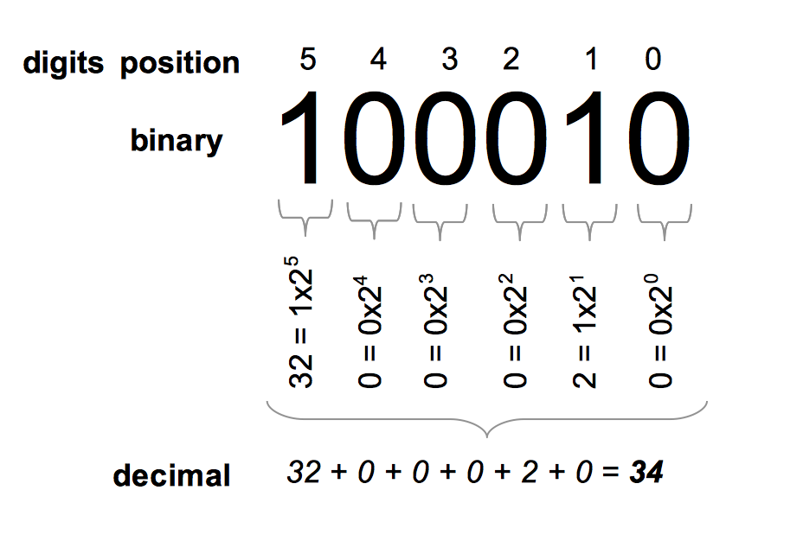
Understanding Binary Numbers
Binary System: A way to write numbers using only 0s and 1s.
Why Binary?
Computers use electronic circuits that are either on (1) or off (0), so they store numbers this way.
How Binary Works:
Just like in decimal (base 10) where each digit is worth 10 times more than the one before, in binary, each digit is worth 2 times more.
Example: The binary number 1011 is the same as 11 in decimal.

Slide 5
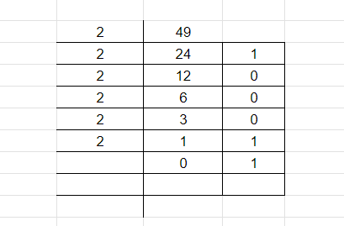
Converting Decimal to Binary
The common method for converting a decimal number to binary involves repeatedly dividing the number by 2 and noting the remainder. Here's the process:
1. Divide the decimal number by 2.
2. Record the quotient to use for the next step.
3. Capture the remainder, which represents the binary digit.
4. Repeat the process until the quotient becomes 0.
5. The remainders are to be read from bottom to top to obtain the binary equivalent.
6. Eg: Binary of 49 is 110001

Slide 6
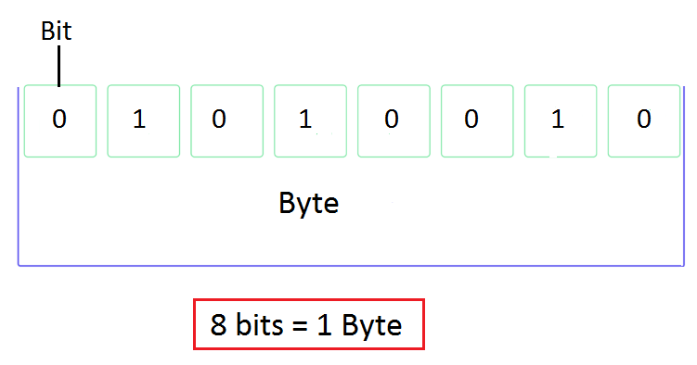
What Are Bits and Bytes ?
Bit: The smallest piece of information a computer can store, either 0 or 1.
Byte: A group of 8 bits. One byte can represent 256 different values.
Example: A single letter like 'A' is stored using 1 byte.
Data Sizes:
Kilobyte (KB) = 1024 bytes (enough for a small text file).
Megabyte (MB) = 1024 KB (enough for a song).
Gigabyte (GB) = 1024 MB (enough for a movie).

Slide 7
What is Hexadecimal ?
Hexadecimal (or hex) is a base-16 number system.
It uses 16 symbols: 0-9 and A-F (where A = 10, B = 11, up to F = 15).
Why Hexadecimal?
It’s easier to read and write than long binary numbers.
Converting Binary to Hex:
Break the binary number into groups of 4.
Example: 10101111 in binary is AF in hex.
Hex is used for:
Memory addresses in computers.
Color codes on websites (e.g., #FF5733 for orange).

Slide 8
How Different Data is Stored
Text: Saved using codes like ASCII or Unicode.
Images: Made of pixels with colors stored using RGB values.
Audio: Sound waves are broken into samples and saved as numbers.
Video: A series of images (frames) combined with audio.

Slide 9
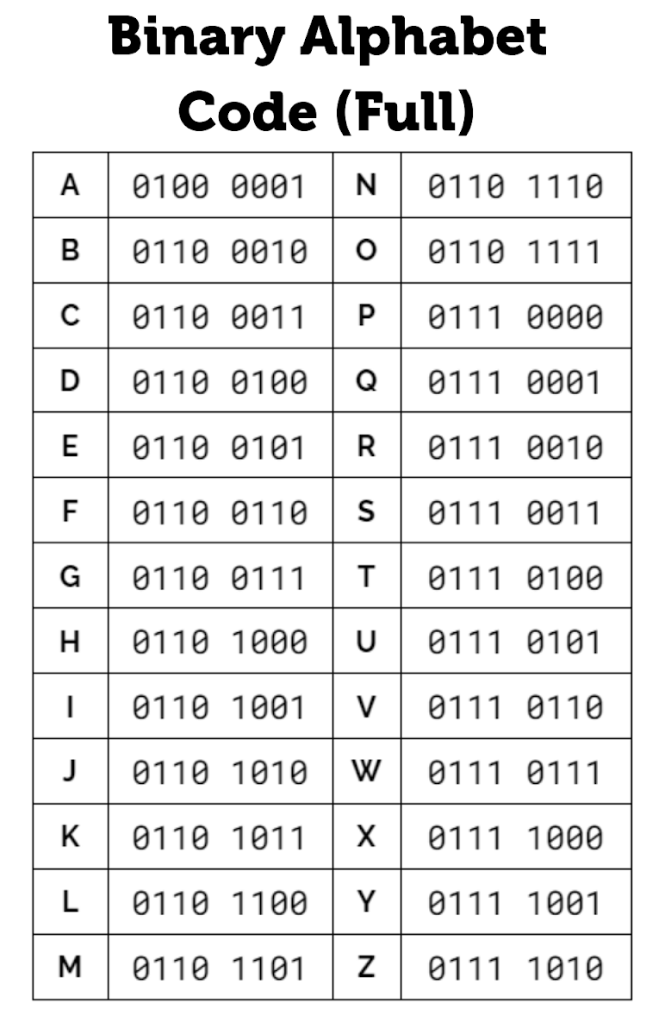
How Do Computers Store Text ?
Computers use codes to save text.
ASCII (American Standard Code for Information Interchange):
Every character (letter, number, or symbol) has its own code.
Example: The letter 'A' is stored as 01000001 in binary.
Unicode:
Used to save more characters from different languages, including emojis.
Example: The word "HELLO" is stored as:
H: 01001000
E: 01000101
L: 01001100
L: 01001100
O: 01001111

Slide 10
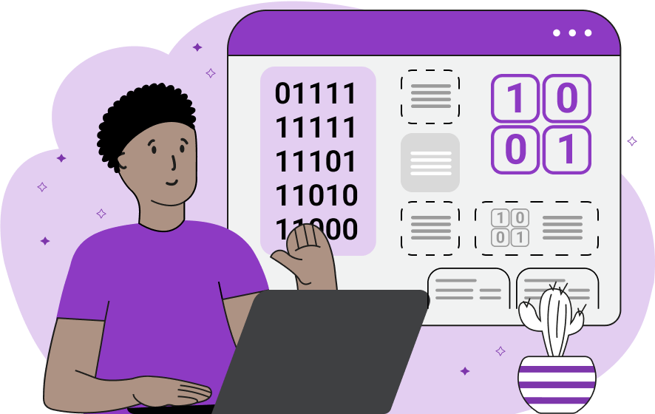
How Do Computers Store Images ?
Images are made up of tiny dots called pixels.
Each pixel has a color, and computers store that color using numbers.
RGB Model: Colors are created by mixing Red (R), Green (G), and Blue (B).
Each color (R, G, B) gets 8 bits (256 values), so a single pixel uses 24 bits.
Example: A red pixel is stored as (R: 255, G: 0, B: 0).
Image Formats:
JPEG: Saves images in a smaller size (compressed).
PNG: Keeps all the image details (uncompressed).

Slide 11
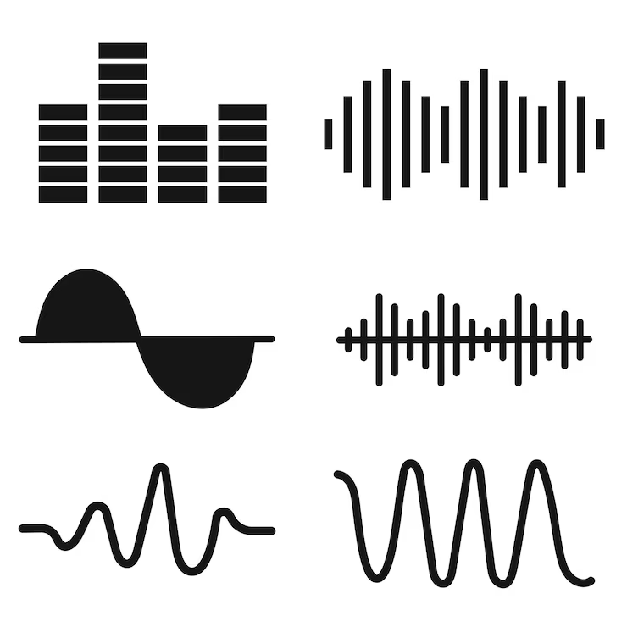
How Do Computers Store Sound ?
Sound is stored as a wave. Computers break the sound wave into small parts called samples.
Sampling Rate: How many times per second the computer records a sample (measured in Hertz or Hz).
Example: CD-quality sound uses 44,100 samples per second.
Audio Formats:
WAV: Stores the sound without any compression (larger file size).
MP3: Stores the sound in a smaller size by removing unnecessary parts (compressed).

Slide 12
Summary and Review
Binary is the language computers use to store all types of data.
Bits and Bytes are the building blocks of all digital information.
Hexadecimal is a shortcut to read and write long binary numbers.
Different types of data (text, images, sound) are stored using their own special methods, but they all rely on binary.

Slide 13
Activity
1. What is the fundamental unit of data in a computer?
A) Bit
B) Byte
C) Pixel
D) Hertz

Slide 14
Activity
2. Which of the following correctly converts the decimal number 10 to binary?
A) 1010
B) 1100
C) 1001
D) 1110

Slide 15
Activity
3. How is text typically stored in a computer system?
A) As sequences of pixels
B) As binary-coded data
C) As sound waves
D) As chemical signals

Slide 16
Activity
4. Which of the following represents a byte?
A) 4 bits
B) 8 bits
C) 16 bits
D) 32 bits

Slide 17
Answers
Here are the answers:
A) Bit
A) 1010
B) As binary-coded data
B) 8 bits

Slide 18
Home Work
Find the Binary representation of the following decimal numbers:
43
25
100
75

